Slide 1
Prediction of Stroke
Capstone Presentation- 10 Apr 2021
By S Buvana
Notes:
Good morning everyone. Today I will be presenting on the following topic. We will be looking at the problem statement of detecting Stroke occurrence using machine learning and deep learning models.

Slide 2
TABLE OF CONTENTS
01
04
02
05
03
Problem Definition
Modelling & Performance
Scope, Business Vs Data Questions
Machine and Deep Learning Algorithm
EDA
Summary
Data Wrangling and Visualisations
Robustness of ML and DL models
Feature Selection
(A)Forward Feature Selection & (B) PCA
Notes:
This the table of contents. I will show the problem statement, take you through some of the EDA plots and feature selection processes before presenting the model and results.

Slide 3

Problem Statement
Scope
To predict Stroke occurrences
To build Machine and Deep Learning models on identified features. Use of Accuracy performance metrics on datasets to evaluate robustness of models.
Notes:
The problem statement that we are aiming to solve is to predict the stoke occurences. We will work on the dataset from Kaggle where there is a compilation of patients’ information on their general health parameters and lifestyle descriptors. The objective is to build machine and deep learning models to predict who are prone to Stroke. The scope of this project is to run the learning models on two datasets using two different feature selection methods. We will then use accuracy as the performance metrics for evaluation. Agenda of today’s ppt.

Slide 4
Data Process
Feature Selection
Problem Definition and Scope
Validation of results
EDA
Machine and Deep Learning Algorithms

Slide 5
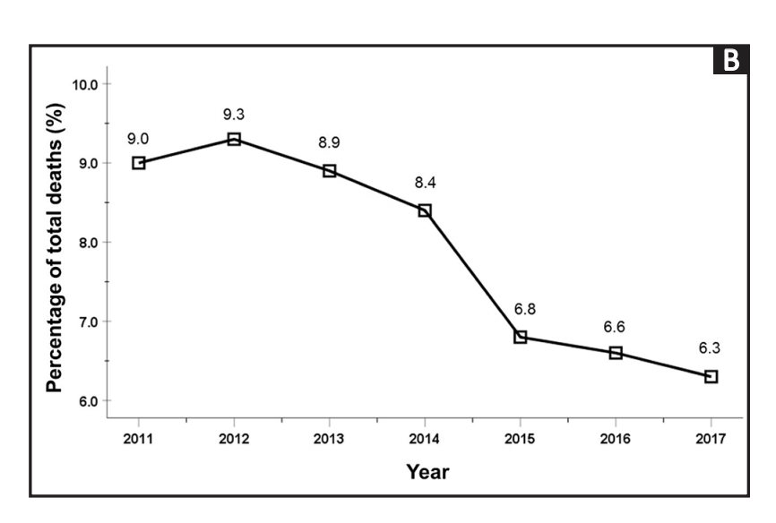
Background
Very much of a concern in Singapore
Mortality rates from Stroke -9%to 6.3% from 2011 to 2017.
Fourth leading cause of death in Singapore
Need for improvements
Deploying prediction models to study the trends will help in early detection of Stroke
Source: Annals Academy of Medicine, Singapore
Notes:
To set the context mortality rates from Stroke have reduced from over the years however, it still remains as the 4th leading cause of death in Singapore.And deploying predictive tools can help to effectively study the trends and help in the early detection of Stroke.

Slide 6

Outcomes
Desirable Business Outcome
To detect Stroke accurately and quickly which brings about cost savings.
Desirable Data Outcome
The model to be deployed to detect Stroke with speed and accuracy.
Notes:
Desirable business outcome is to detect Stroke quickly and accurately which translates to cost savings with data outcomes of predicting with speed and accuracy.

Slide 7
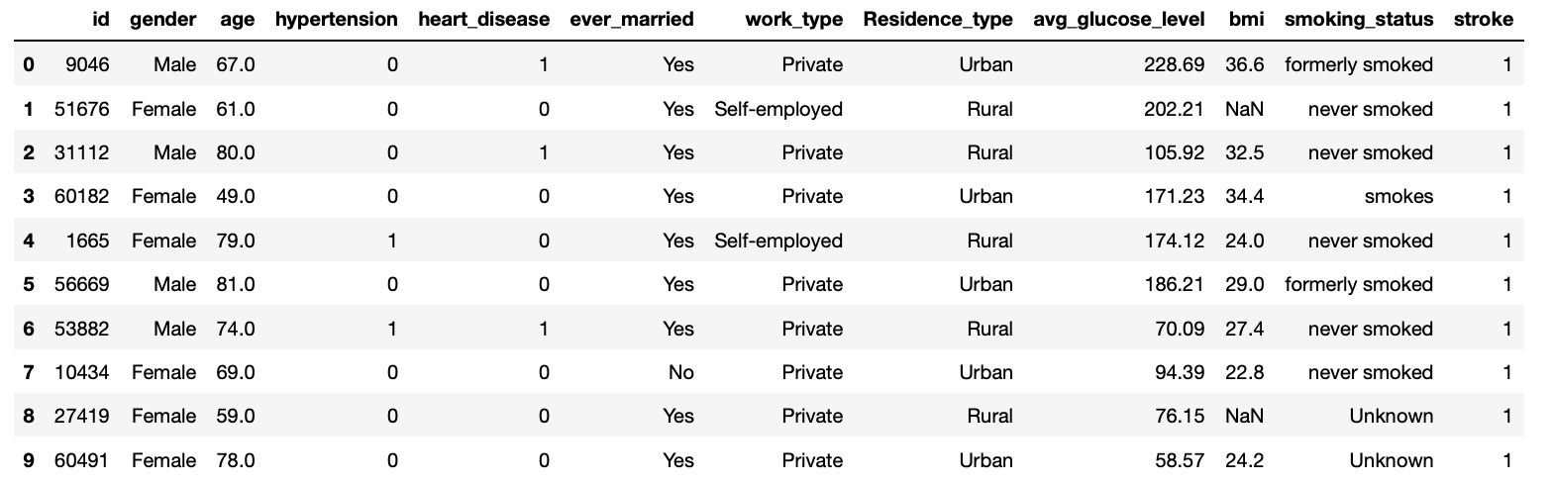
Data
Kaggle dataset- Stroke prediction
5110 Rows & 12 Columns- Target variable is Stroke
5 Categorical variables (Dummy Encoding)
Normalisation of dataset

Slide 8
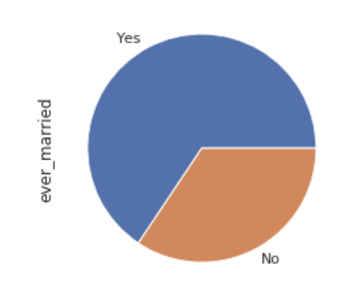
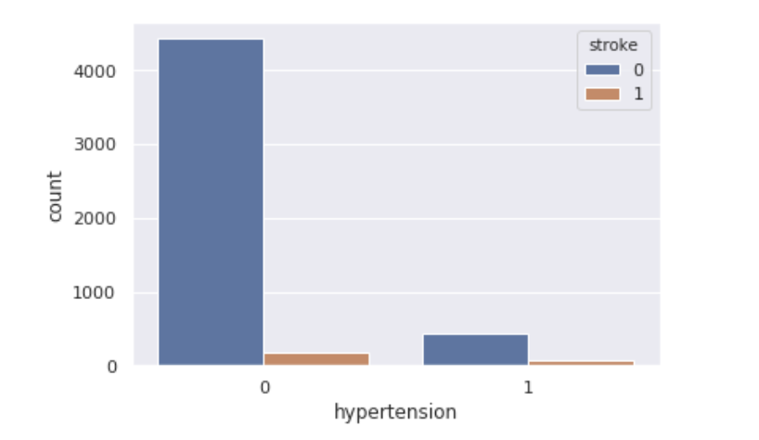
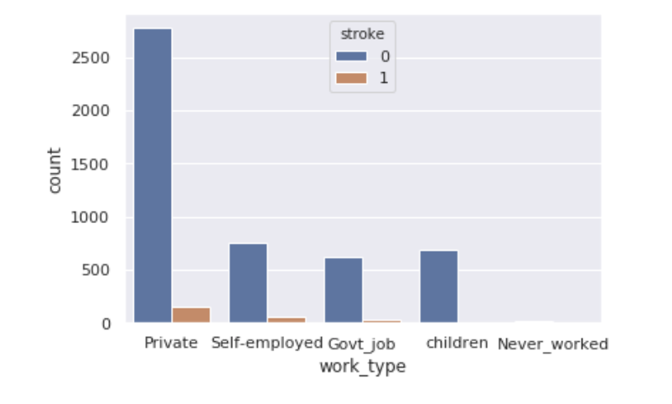
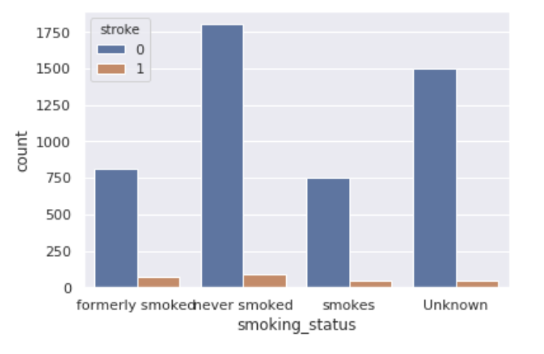
EDA
Notes:
These are some plots. We can see the maritial status. However, the plots show that variables such hypertension, working type and smoking status doesn’t clearly show the correlation with stroke occurrence. We had to take a deep dive.

Slide 9
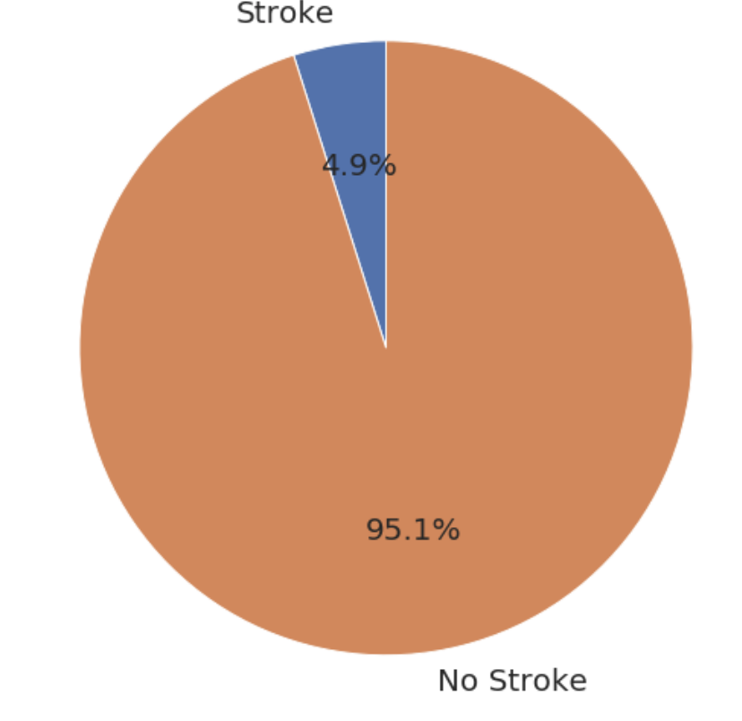
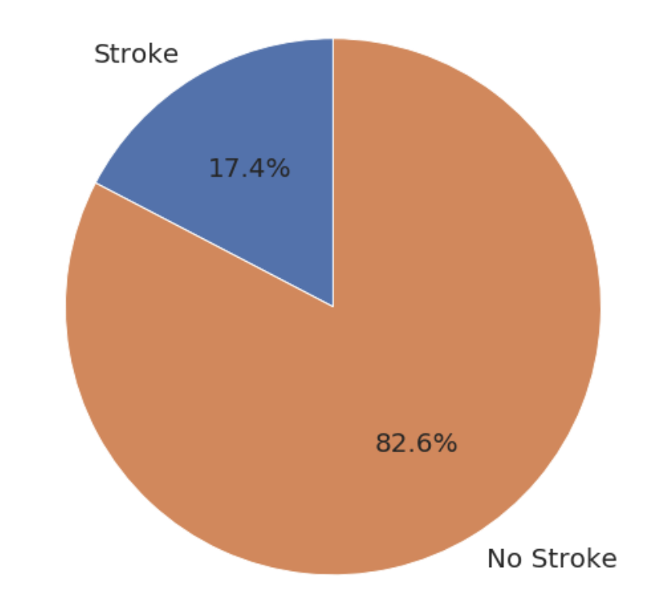
EDA
Unbalanced dataset with only 4.9% of data points are Stroke patients
Resampling method to artificially inflate the minority class (with Stroke)
From 4.9% to around 17.4%- Model analysis were run on resampled dataset
Notes:
When I plotted the counts of the stroke there was a stark unbalance in the number of stroke and no stroke cases . From the given dataset only 4.9% had stroke. Hence I had to carry out resampling method to balance target variables. We inflated the count to reflect a 17.4%-82.6% to train the model for a meaningful analysis.

Slide 10
Feature Selection
Forward Feature Selection(FFS)
PCA
Predictor Columns:'age', 'work_type_4', 'avg_glucose_level', 'ever_married_0', 'heart_disease', 'hypertension', 'bmi', 'work_type_2', 'smoking_status_2', 'gender_1'
15 PCA components
Notes:
Next feature selection was done in two ways- these were the resulting variables from forward feature selection and 15 PCA components were identified.

Slide 11
Machine Learning
Machine learning algorithm run on both datasets with variables identified by feature selection methods.
Train/Test split of 80%/20%
Cross validation
Hyper parameter tuning by GridSearch CV
Logistic Regression
KNN Classification
Support Vector
Random Forest
Ada Boosting
Notes:
After the selection of features, these 5 machine learning models were deployed in btoh datasets with train/test split of 80-20% with CV of 10 folds. Gridsearch CV was carried out for parameter tuning.

Slide 12
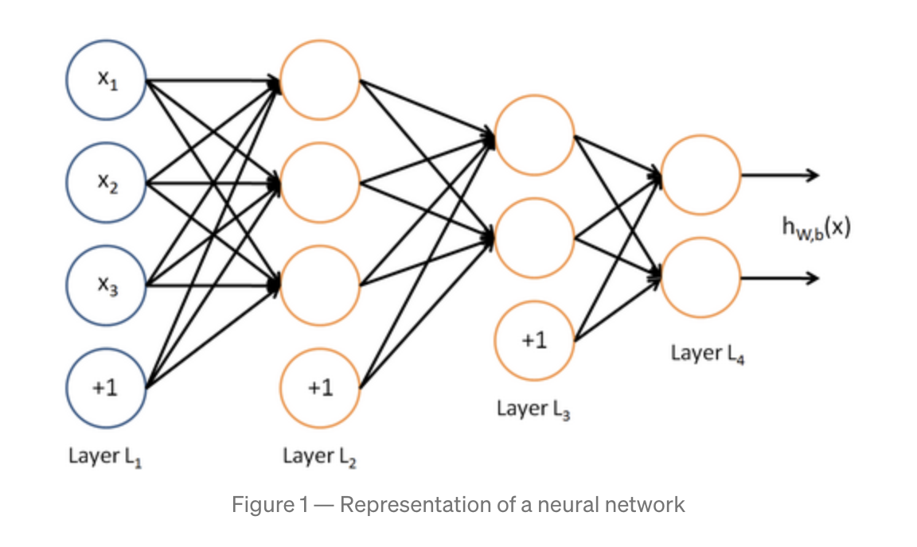
Deep Learning
Deep learning algorithm run on both datasets with variables identified by feature selection methods.
Train/Test split of 80%/20%
Cross validation
Build Artificial Neural Network
Notes:
Next an Artificial neural network was built and deployed on both the datasets. We will be looking at the accuracy results in the next few slides.

Slide 13
Machine Learning
On predictors from Forward Feature Selection

Slide 14
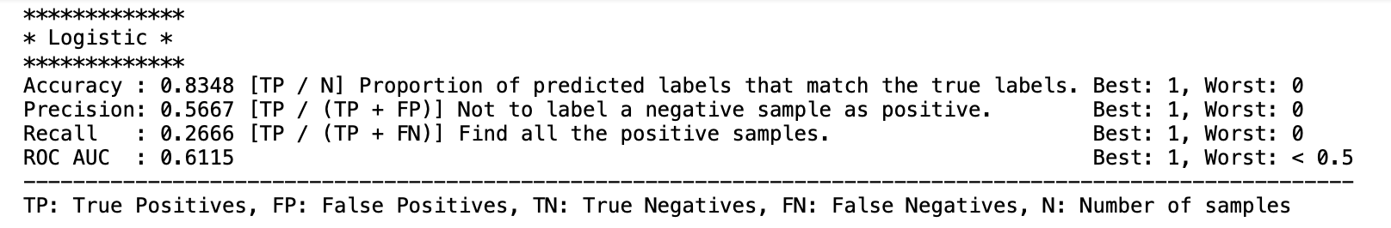
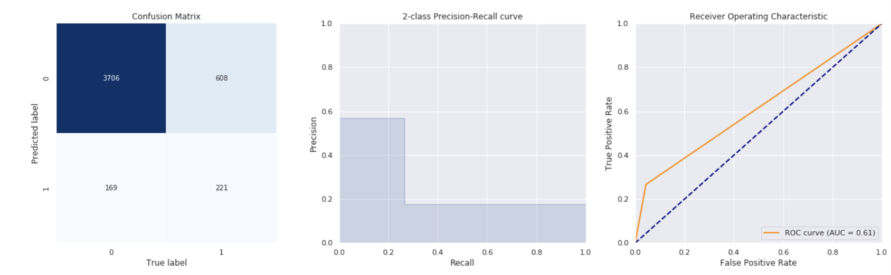
Logistic Regression-FFS
Training Set
Notes:
When we fit logistic on the dataset containing the forward feature selection predictors, the accuracy score for training set was 83.5% with a AUC score of just 61%.

Slide 15
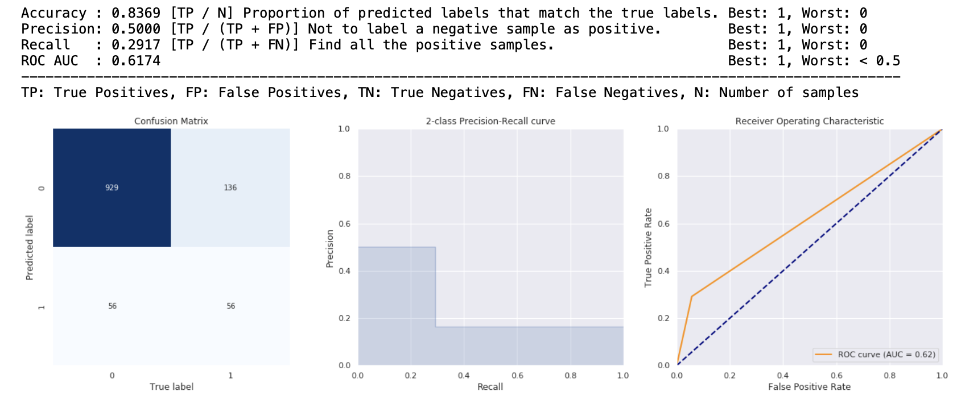
Logistic Regression-FFS
Test Set
Notes:
The accuracy score was 83.6% when the log reg model was deployed on test set.Overfitting is unlikely.

Slide 16
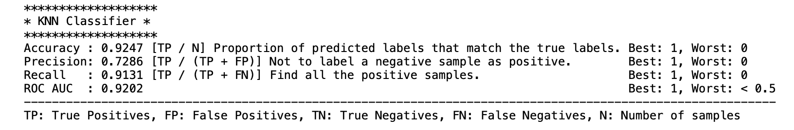
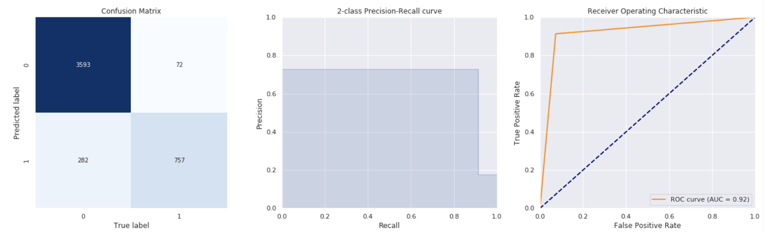
KNN-FFS
Training Set
Notes:
When KNN was fit, accuracy score was higher at 92.5% however dipped to 85.6% when model was deployed on test set.

Slide 17
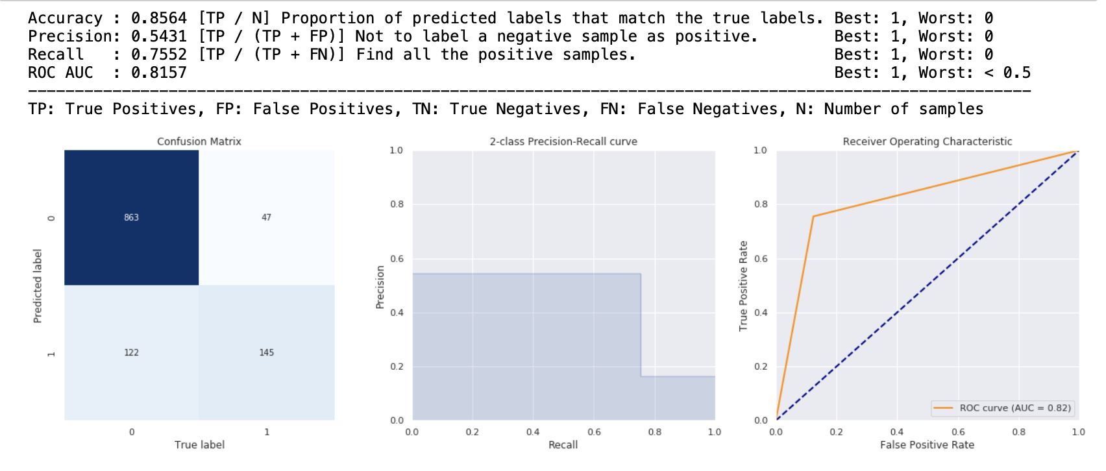
KNN-FFS
Test Set

Slide 18
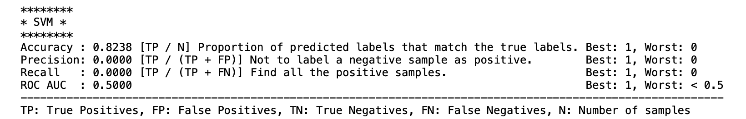
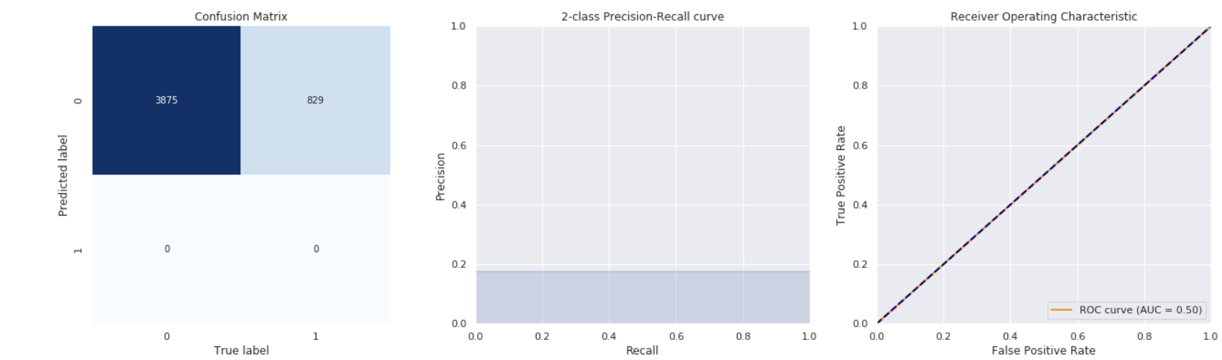
SVM-FFS
Training Set
Notes:
When SVM was fit, accuracy score was lowest yet at 82% .Test set performed better showing overfitting.

Slide 19
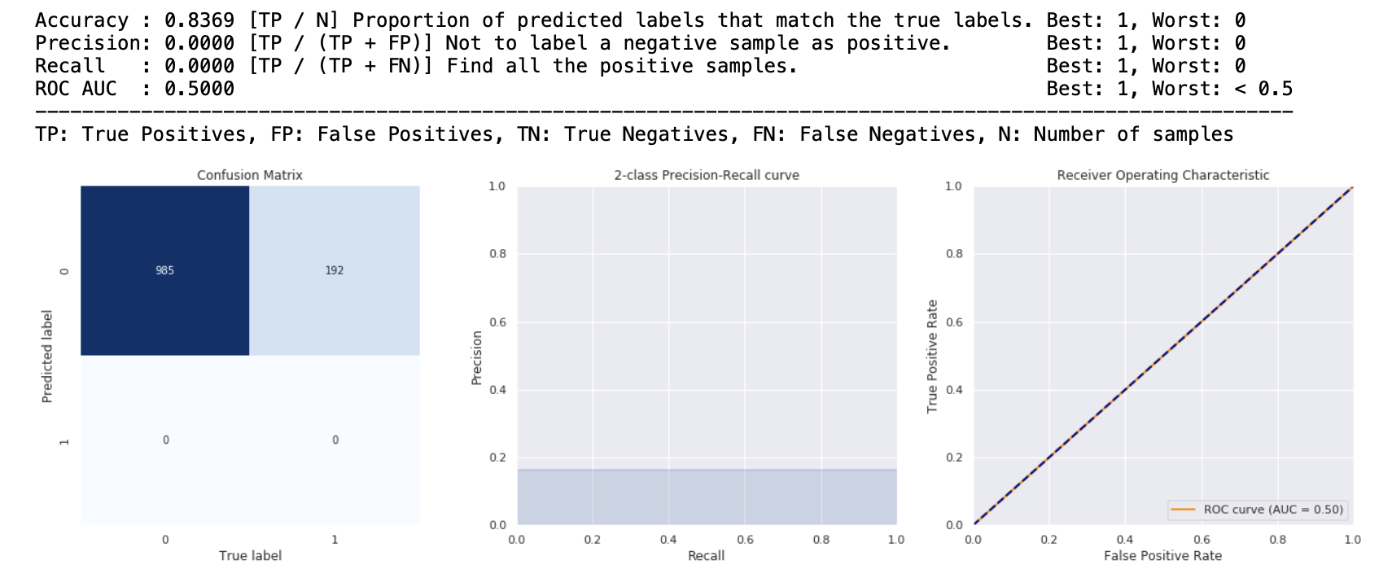
SVM-FFS
Test Set
Overfitted

Slide 20
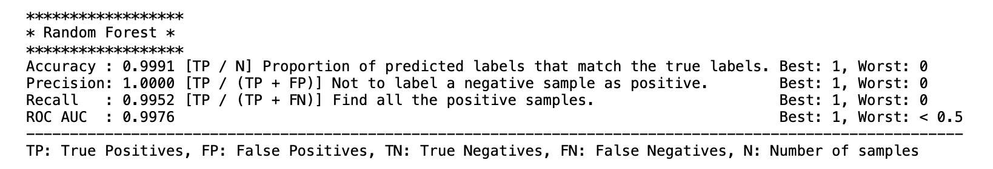
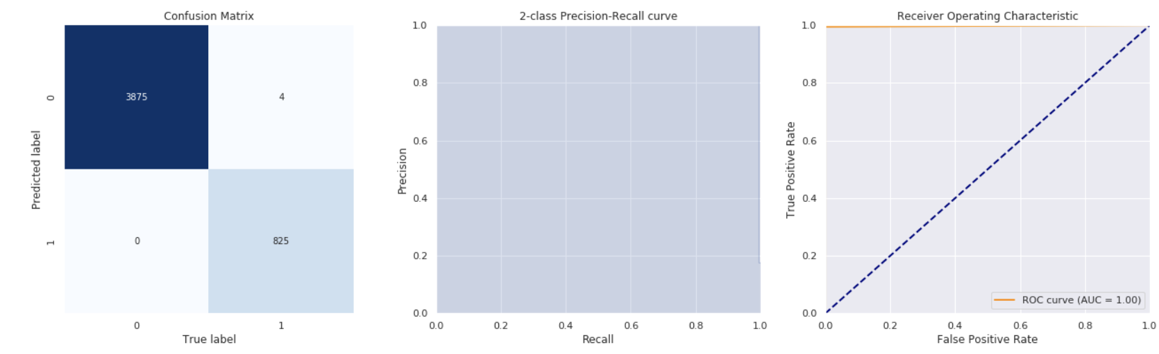
Random Forest-FFS
Training Set
Notes:
The best classifier model was Random forest when it was applied to forward feature selection dataset with accuracy score of 99.9%.

Slide 21
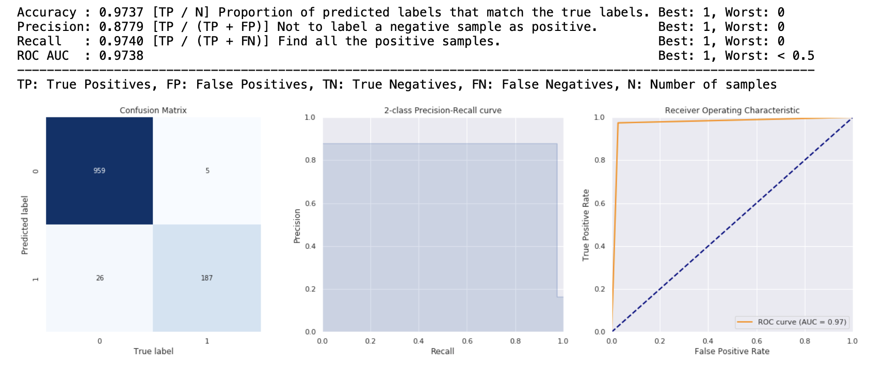
Random Forest-FFS
Test Set
Notes:
The test set did well with high accuracy score of 97%.

Slide 22
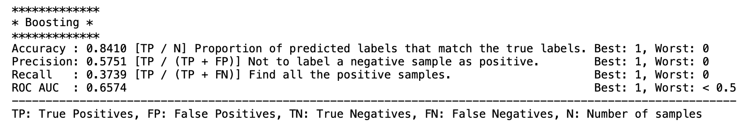
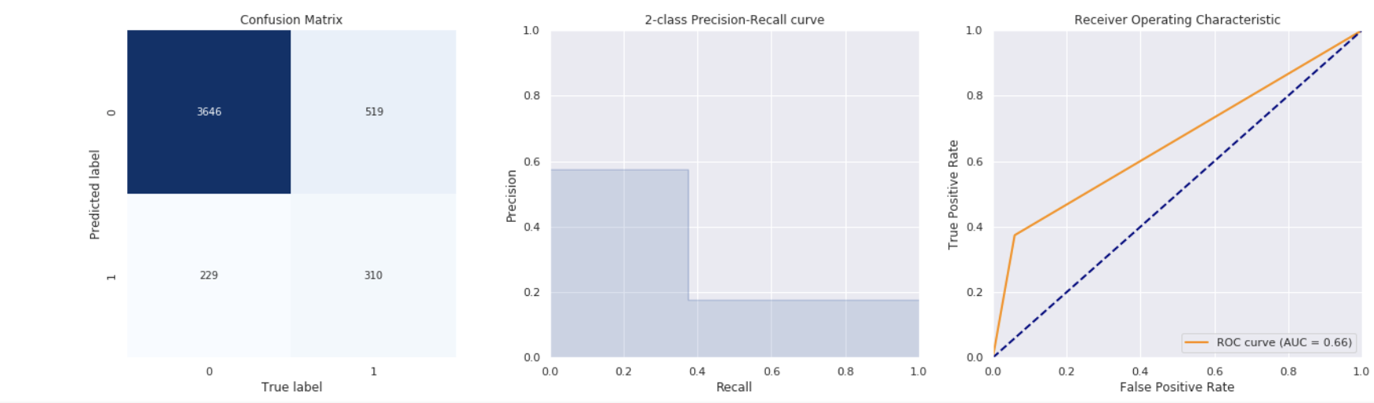
Boosting-FFS
Training Set
Notes:
Finally the results for ADA boost model. The accuracy score is good at 84% when we fit the train set.

Slide 23
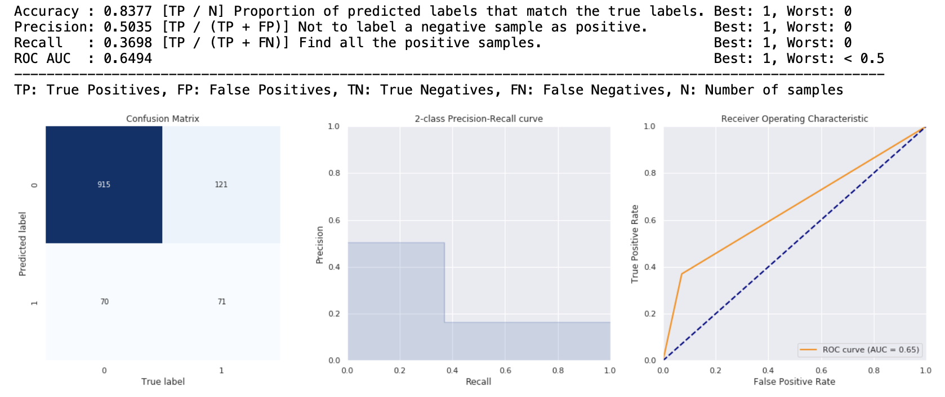
Boosting-FFS
Test Set
Notes:
The accuracy score for the test set did well with 83.7% as well.

Slide 24
Performance Metrics- FFS dataset
Train Dataset | Logistic Regression | KNN | SVM | Random Forest | Ada Boost
Forward Feature Selection -10 X columns | 0.834 | 0.924 | 0.823 | 0.999 | 0.841
Forward Feature Selection -10 X columns with GridSearch CV | 0.835 | 1.0 | 0.824 | 0.999 | 0.856
Notes:
This sums up the training results when we fed the models using the features chosen using feature selection.Random forest performed best. When we applied Gridsearch CV, KNN emerged as the best classifier with 100% accuracy.

Slide 25
Deep Learning
On predictors from Forward Feature Selection

Slide 26
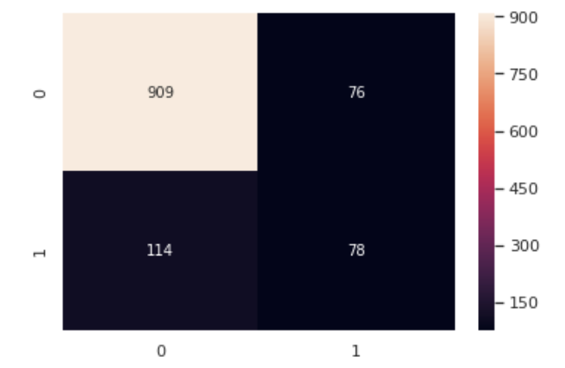
Neural Network- FFS
Keras sequential model
ANN model with 15 Neurons in L1 and 1 hidden layer
Drop out rate :0.2
Optimizer: Adam
Loss: Binary cross entropy
Metrics: Accuracy
100 epoch runs
Model Results
-Accuracy score of prediction model 84.8%
-Good classifier
Notes:
We deployed the neural network with the following parameters with just 1 hidden layer and drop out rate of 0.2 and 100 epochs. The accuracy was good at 84.8 % but didn’t surpass the performance of K Random forest classifier.

Slide 27
Machine Learning
On predictors from PCA

Slide 28
Performance Metrics- PCA dataset
Train Dataset | Logistic Regression | KNN | SVM | Random Forest | Ada Boost
PCA-15 PCA components | 0.835 | 0.924 | 0.824 | 0.999 | 0.862
PCA-15 PCA components with GridSearch CV | 0.835 | 0.835 | 0.824 | 1.00 | 0.936
Notes:
These machine learning algorithms were deployed across the PCA dataset. As you can see the results were not any different.Random forest was consistent and this time with gridsearch CV, random forest attained 100% accuracy and proved as the best classifer.

Slide 29
Deep Learning
On predictors from PCA

Slide 30
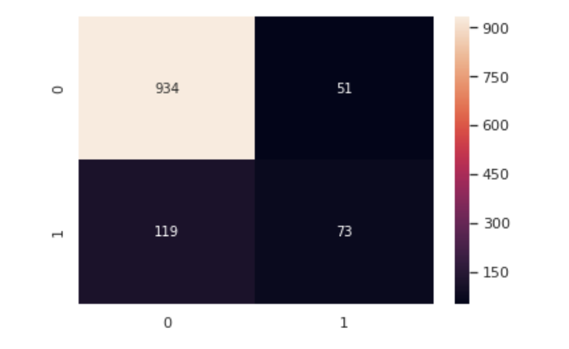
Neural Network- PCA
Keras sequential model
ANN model with 15 Neurons in L1 and 1 hidden layer
Drop out rate :0.2
Optimizer: Adam
Loss: Binary cross entropy
Metrics: Accuracy
100 epoch runs
Model Results
-Accuracy score of prediction model 85.6%
-Good classifier
Notes:
Same NN was run on this dataset and accuracy was slightly improved for this NN model.

Slide 31
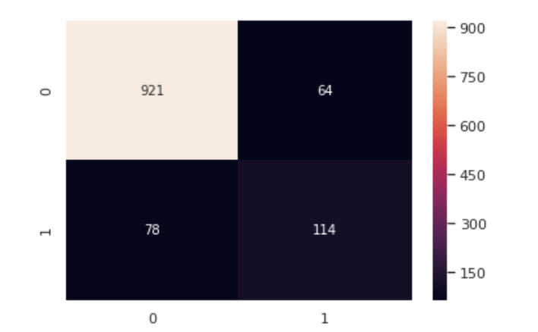
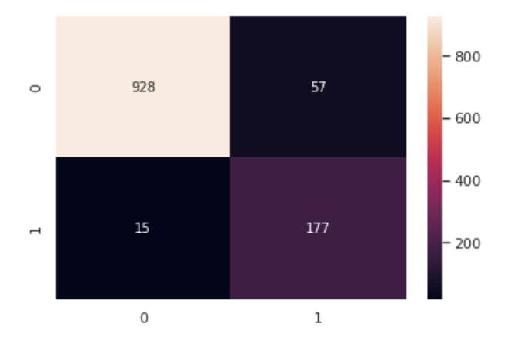
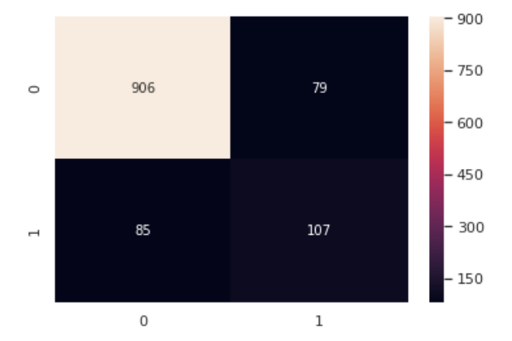
Neural Network- PCA
Parameter tuning- Change batch size to 10
Parameter tuning- Change epoch size to 150
Parameter tuning- Change dropout rate to 0.1
Model Results
Model Results
Model Results
-Accuracy score of prediction model 87.9%
-Slight improvement
-Accuracy score of prediction model 93.9%
-Slight improvement
-Accuracy score of prediction model 86%
-Slight improvement
Notes:
Parameters were tuned for NN model and as you can see the model accuracies have been improved with every iteration.

Slide 32
Conclusions
Based on the data collected, we can use Machine Learning model — Random Forest to help with the prediction of Stroke occurrences. It provided the best accuracy at the rate of 99.9% across both datasets.
AUC Score of 1.00 for and train and 0.97 for test indicates a good classifier and overfitting is unlikely.The recall and precision are high above 90% indicating the exactness and proper classification of data points, which is crucial in detecting diseases.
Medical institutes can detect Stroke in accurate and timely manner to reduce mortality rates further.
Notes:
recall is the measure of our model correctly identifying True Positives. Thus, for all the patients who actually have stroke, recall tells us how many we correctly identified as having a stroke

Slide 33
THANK YOU

Slide 34
RESOURCE LINKS
https://www.annals.edu.sg/pdf/48VolNo10Oct2019/V48N10p310.pdf
https://www.kaggle.com/kanishkkavdia/stroke-prediction-using-ann-deep-learning-model

Slide 35
CREDITS
This is where you give credit to the ones who are part of this project.
Did you like the resources on this template? Get them for free at our other websites.
Presentation template by Slidesgo
Icons by Flaticon
Infographics by Freepik
Images created by Freepik
Text & Image slide photo created by Freepik.com

Slide 36
Appendices

Slide 37
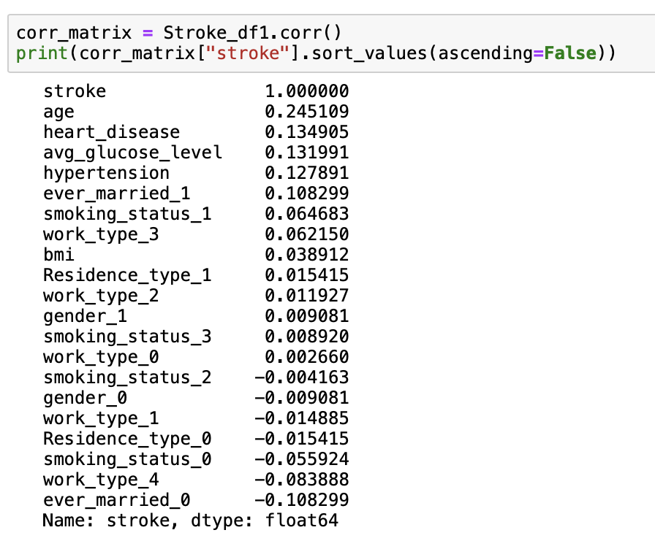
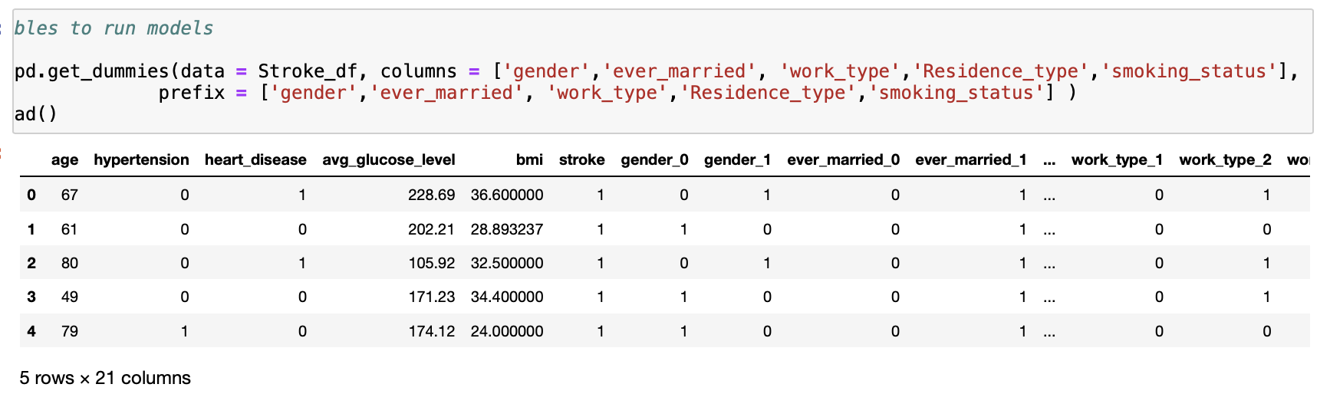
Encoding and Correlation

Slide 38
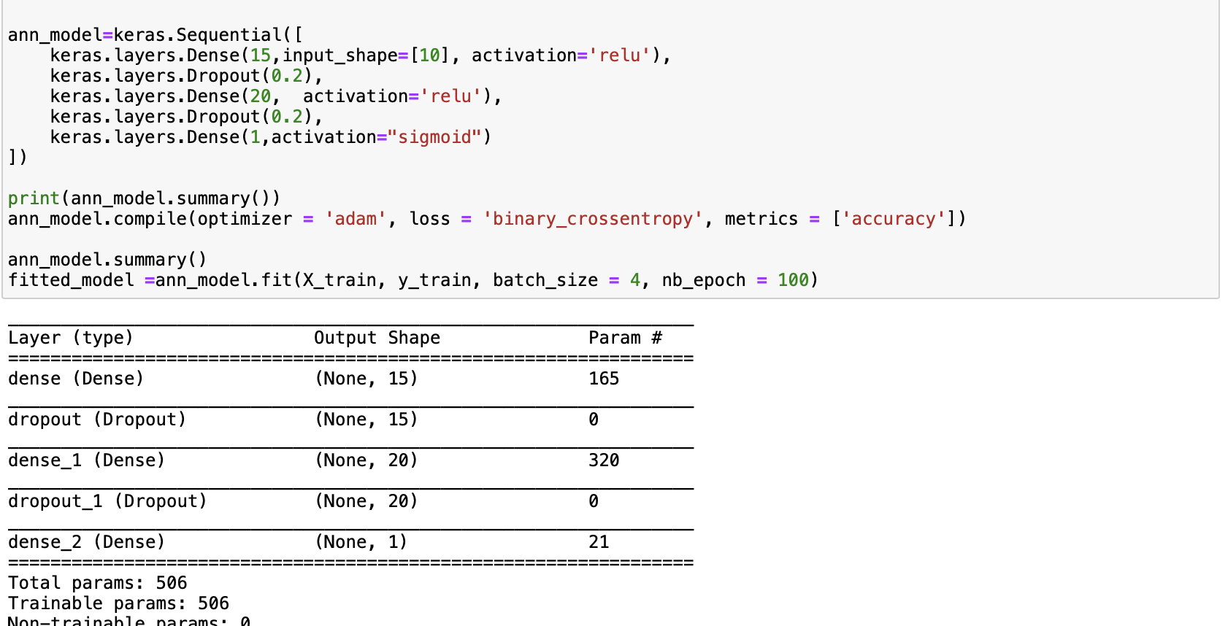
ANN

Slide 39
Performance Metrics
If resampling is tuned to reflect 50%-50% of target variable

Slide 40
Performance Metrics- PCA dataset
Generally Models didn’t perform as well in comparison
Train Dataset | Logistic Regression | KNN | SVM | Random Forest | Ada Boost
PCA-15 PCA components | 0.776 | 0.934 | 0.778 | 0.999 | 0.811
PCA-15 PCA components with GridSearch CV | 0.776 | 0.835 | 0.824 | 0.999 | 0.936

